Slide 1
Malware Attribution Using the Rich Header
Seamus Burke Kevin Bilzer RJ Joyce
Notes:
Briefly talk about what the Rich header is

Slide 2



About Us
www.linkedin.com/in/seamus-h-burke/
www.linkedin.com/in/kevin-bilzer-jr/
www.linkedin.com/in/rj-joyce/
Notes:
Shmooze-a-student
Name, year, year in school, our major, thing which interests you and a fun fact

Slide 3
Agenda
1. PE File Metadata
2. The Rich Header
3. Prior Research
4. Packers
5. Metadata Hashing
6. RichPE Metadata Hash
7. Rich Header Tamper Detection
8. Conclusion
Notes:
Before we can talk about the Rich header, need to introduce PE file metadata and how it is useful for malware analysis
Will discuss prior research that involves the Rich header and Malware analysis
The findings about packers from one of the papers interested us, so we did some research on it ourselves
Led us to develop a metadata hash called RichPE
Another article discussed how a Rich header was used as a false flag
Researched how feasible it is to spoof / tamper with a Rich header and get away with it

Slide 4
PE File Metadata
Notes:
Transition:
Metadata of PE files is very useful to malware analysts
Many malicious executables have unusual metadata
Similar malware samples often have similar metadata
Will be talking about topics related to PE file metadata a lot during the talk, so need to go over background info first

Slide 5
What is the PE File Format?
File format for Windows executables
About a dozen file types, most notably EXE, DLL, and SYS
Describes how the executable is loaded into memory

Slide 6
The MS-DOS Stub Header
Included for legacy DOS compatibility
“!This program cannot be run in DOS mode.”
Contains Relative Virtual Address of PE header
MS-DOS Stub
IMAGE_FILE_HEADER
IMAGE_OPTIONAL_HEADER
Section Table
IMAGE_SECTION_HEADER
IMAGE_SECTION_HEADER
IMAGE_SECTION_HEADER
Notes:
If a PE file is run on a DOS system, it prints the error instead of just crashing

Slide 7
The IMAGE_FILE_HEADER
Basic file information:
NumberOfSections
TimeDateStamp
Characteristics
MS-DOS Stub
IMAGE_FILE_HEADER
IMAGE_OPTIONAL_HEADER
Section Table
IMAGE_SECTION_HEADER
IMAGE_SECTION_HEADER
IMAGE_SECTION_HEADER
Notes:
Sub bullets for characteristics

Slide 8
The IMAGE_OPTIONAL_HEADER
Not actually optional
Contains lots of important file metadata:
AddressOfEntryPoint
Sizes of various parts of the file that get loaded into memory
Versions of linker, OS, image, subsystem
MS-DOS Stub
IMAGE_FILE_HEADER
IMAGE_OPTIONAL_HEADER
Section Table
IMAGE_SECTION_HEADER
IMAGE_SECTION_HEADER
IMAGE_SECTION_HEADER
Notes:
some instead of “a bunch”

Slide 9
The Section Table
Contains array of IMAGE_SECTION_HEADERs
Each contains that section’s:
Name
VirtualAddress
VirtualSize
SizeOfRawData
Characteristics
MS-DOS Stub
IMAGE_FILE_HEADER
IMAGE_OPTIONAL_HEADER
Section Table
IMAGE_SECTION_HEADER
IMAGE_SECTION_HEADER
IMAGE_SECTION_HEADER
Notes:
Section is contiguous block of memory in virtual address space of a process

Slide 10
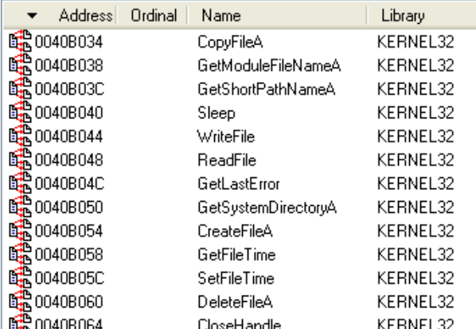
The Import Address Table (IAT)
Located in the .idata section
Lists DLLs and functions imported from them
Notes:
Emphasize usefulness for malware analysis

Slide 11
The Rich Header

Slide 12
The Rich Header
Included in PE files built with the Microsoft compilation toolchain
Located between the MS-DOS stub and PE header
Contents are obfuscated, undocumented
Notes:
Since around 1998

Slide 13
Rich Header Backstory
Developers afraid Microsoft was storing personal info in Rich header
“Devil’s Mark”
Speculation that Microsoft was using it to track malware authors
Article about how to de-obfuscate the Rich header published in 2008 by Daniel Pistelli

Slide 14
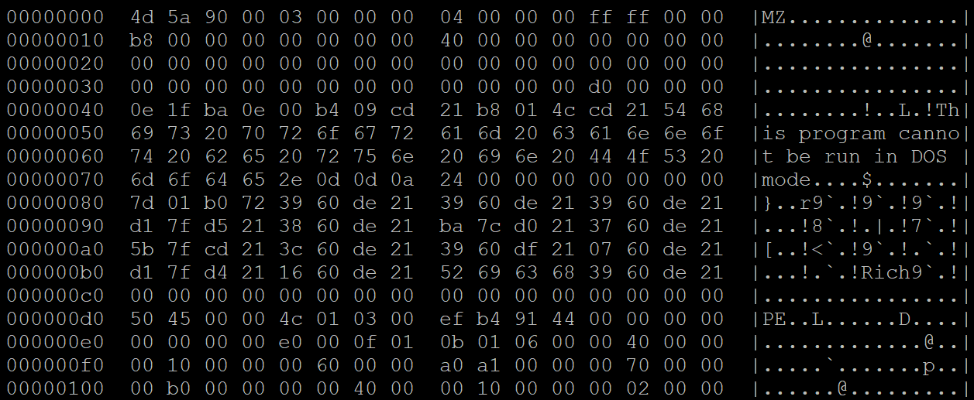
What it Looks Like
MS-DOS Stub
Rich Header
PE Header

Slide 15
Rich Header Checksum
The 4 bytes after “Rich” are a checksum
Linker calculates it based on:
MS-DOS stub length
MS-DOS stub contents
Contents of the Rich header
Contents of the Rich header are obfuscated using checksum as an XOR key
Notes:
“Devil’s Mark”

Slide 16
De-Obfuscated Rich Header
4 bytes
4 bytes
“DanS” |  | Padding
Padding |  | Padding
ProdID | mCV | Count
ProdID | mCV | Count
…
“Rich” |  | Checksum
Padding |  | Padding
Header
Entries
Footer

Slide 17
How the Rich Header is Built
The backend compiler (c2.dll) inserts the @comp.id into each object it generates during compilation
The linker reads in all this information, keeps track of how many times each object is used, and builds the Rich header
c1.dll
*.dll
cl.exe
c2.dll
*.obj
link.exe
*.exe
*.lib
Notes:
Need to mention that a @comp.id is a ProdID + an mCV

Slide 18
Prior Research

Slide 19
The Rich Header + Malware Analysis
Very little public literature that incorporates both
Finding the Needle: A Study of the PE32 Rich Header and Respective Malware Triage, Webster et. al
The Devil’s in the Rich Header, Securelist blog
Case Studies in Rich Header Analysis and Hunting, Ropgadget blog

Slide 20
Finding the Needle
Surveyed over 1 million PE files, ~70% had Rich headers
How packers affect the Rich header
Identifying metadata tampering
Finding related malware samples

Slide 21
The Devil’s in the Rich Header
OlympicDestroyer worm was an attribution nightmare
Had Rich header identical to wiper used by Lazarus group
Article proved that OlympicDestroyer’s Rich header was a false flag
mscoree.dll
Notes:
“Who wasn’t responsible for OlympicDestroyer?”
APT3, APT10 -> China
Sandworm -> Russia
Lazarus group -> NK
Fake Rich header vs DLL thing?

Slide 22
Case Studies in Rich Header Analysis
Using YARA to track malware by Rich header contents
import "pe"
import "hash"
rule rich_example {
condition:
hash.md5(pe.rich_signature.clear_data) == "[MD5]"
}
Notes:
This rule matches on the md5 of the entries in the Rich Header

Slide 23
Packers and the Rich Header
Notes:
Transition:
The results from the Finding the Needle paper interested us, wanted to replicate with more packers

Slide 24
Packers 101
Obfuscates executable code
Inhibits static analysis
Original PE file
Unpacking stub
Packed data
Notes:
Only executable code that can be analyzed is unpacking stub
Unpacker stub unpacks the packed data in memory and executes it
Often breaks antivirus signatures that rely on byte sequences

Slide 25
Finding the Needle Packer Results
Surveyed 5 common malware packers
UPX, ASPack, NSIS do not modify the Rich header
Found that other packers may corrupt / remove the Rich header

Slide 26
Our Own Findings
Packer Name | Not Modified | Inadvertently Modified | Purposefully Modified
ASPack | X
PECompact | X
Petite | X
Themida | X
UPX | X
FSG |  | X
Upack |  | X
VMProtect |  | X
RLPack |  |  | X
Notes:
Want to test more packers
Mention that we packed with strictest options

Slide 27
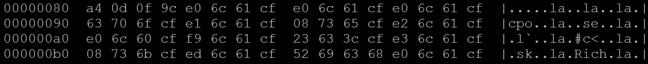
RLPack
Rich header of unpacked sample:
Rich header of sample packed with RLPack:

Slide 28
Metadata Hashing
Notes:
We know that malware samples with similar Rich headers are likely to be related
In combination with our packer results, led us to develop a metadata hash
Need to introduce metadata hashing + review some industry standard metadata hashes first

Slide 29
What is a Hash Function?
Maps arbitrary-length data to a fixed-length digest
Properties of cryptographic hash functions:
Deterministic
Not reversible
Resistant to collisions
Arbitrary Length Data
Hash Function
Digest

Slide 30
What is Metadata Hashing?
Used to efficiently query malware samples that share metadata
Use malware metadata as input to a hash function
Store malware in a database indexed on metadata hash
Notes:
Which metadata to use as hash function input?

Slide 31
Imphash
Hash of functions in the order they are listed in the IAT
Malware samples with same Imphash likely have similar source code

Slide 32
Imphash Weaknesses
Low confidence if a malware sample does not have many imports
Packed malware frequently uses runtime linking
Changes the imphash, hinders static analysis of imports
Notes:
Which metadata to use as hash function input?

Slide 33
Pehash
Uses metadata from:
IMAGE_FILE_HEADER
IMAGE_OPTIONAL_HEADER
IMAGE_SECTION_HEADERs
Polymorphic malware from the same family will often share a pehash
Notes:
Some values have lowest bits masked out
Polymorphic malware

Slide 34
Pehash Weaknesses
Very strict - high confidence but high false negative rate
Packing a malware sample almost always changes its PE sections
Changes the pehash because it relies on section metadata
Notes:
Some values have lowest bits masked out
Polymorphic malware

Slide 35
RichPE Metadata Hash

Slide 36
How the RichPE Hash is Computed
Rich Header Entries | ProdID
 | mCV
 | Masked Count
IMAGE_FILE_HEADER | Machine
 | Characteristics
IMAGE_OPTIONAL_HEADER | Subsystem
 | MajorLinkerVersion
 | MinorLinkerVersion
 | MajorOperatingSystemVersion
 | MinorOperatingSystemVersion
 | MajorImageVersion
 | MinorImageVersion
 | MajorSubsystemVersion
 | MinorSubsystemVersion
Notes:
Count – Half of the lowest bits are masked out
Why I selected values
Leave out section metadata
pefile

Slide 37
Metadata Hashes vs ASPack
 | Original File | Packed file
MD5 | 0c5e9f564115bfcbee66377a829de55f | 0c685b6a355eb493e9e07296ba95619c
Imphash | 63bf00403dae8328fff132b19e7e9b46 | 1417f7317798bb198313884c0e6740a4
Pehash | a2793a4e5a7c5c55549b0f6c8551ccb575713eb2 | 6e4a9338bf5378a218dda0336142872e9d29f8aa
RichPE | 8f6dcb3f2e8facfc3f8ba79ff5cdea50 | 8f6dcb3f2e8facfc3f8ba79ff5cdea50

Slide 38
Metadata Hashes vs PECompact
 | Original File | Packed file
MD5 | c627e595c9ec6dc2199447aeab59ac03 | c1732007b2972d782fc833c424f10f20
Imphash | 387de552b3e0b8567609f40c93db20c5 | None
Pehash | 24c52a685c65c40943cd7b7d1a63f6e772da71eb | 8e570144c042fda180677f16c83b26492d93394c
RichPE | 7569682a56f9fc1e307cc57e1bd3412a | 7569682a56f9fc1e307cc57e1bd3412a

Slide 39
Metadata Hashes vs Petite
 | Original File | Packed file
MD5 | 995442f722cc037885335340fc297ea0 | f366ca2f54ed38c555d8230071611212
Imphash | 8e6265b4d84471cbb32c119bcd93dc47 | 318e98359811909d24ad34aac812aa63
Pehash | e88e1fc9d900ccd770deb492ff855f499d2fb238 | abd8ad4daab0aa3b1dc36a19cde3c23fafe77868
RichPE | 7ef53a9bafca2bd6f35f1692697e28d8 | 7ef53a9bafca2bd6f35f1692697e28d8

Slide 40
Metadata Hashes vs Themida
 | Original File | Packed file
MD5 | 6b31344b40e2af9c9ee3ba707558c14e | 99ac9ccb4f0db04f24f2c80d8f6e46b3
Imphash | 5776b1400eb618f9f213ae9dee30ce2f | baa93d47220682c04d92f7797d9224ce
Pehash | 48be6716fa7c6d8bb7256138690662badf1fe5e9 | ee636745bdab534b65a6a447525a84ba2d9ca10a
RichPE | e315a4477592046c9cbf7652003732b1 | e315a4477592046c9cbf7652003732b1

Slide 41
Metadata Hashes vs UPX
 | Original File | Packed file
MD5 | 6b97b3cd2fcfb4b74985143230441463 | f7fe21ab370efc5c4b4478627189f011
Imphash | ba47a0478b3cdd3b7d2c2438b409a2ca | e21e17ff820bc123b050075aae0d0a6b
Pehash | eea113541bb30c2a955f9253fcd65bad609e2e6d | 896c92b861ae1b4457ecce0002dedbeb3e8a13ad
RichPE | 3ee78f0e6bd1d24dc1a7820e95f9b604 | 3ee78f0e6bd1d24dc1a7820e95f9b604

Slide 42
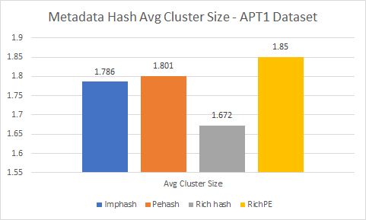
Metadata Hash Stats - APT1 Dataset
Notes:
Imphash did not cluster perfectly, one FP (5 imports)
Rest clustered by family (209 samples, 38 families)

Slide 43
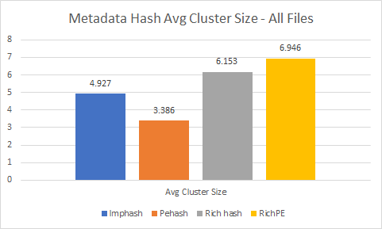
Metadata Hash Stats - All Files

Slide 44
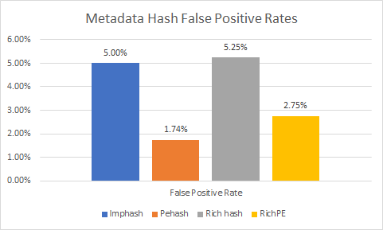
RichPE Hash Accuracy
Notes:
~300,000 malware
~330,000 clean
File infectors/polymorphic malware could account for false positives

Slide 45
Other Cool RichPE Findings
Identified probable APT1 malware in the VirusShare dataset
Identified unpacked and packed malware of the same family
Identified malware samples of the same family packed with different packers

Slide 46
RichPE Weaknesses
Doesn’t work on malware without a Rich header
Not all packers leave the Rich header alone
Still in proof-of-concept stage, need to do more testing

Slide 47
Rich Header Tamper Detection
Notes:
Given all the stuff RJ just said before hand, rich header metadata is really powerful, and we expect more actors to be tampering with it in the future, what are some ways we might be able to detect the tampering

Slide 48
Motivation
Adversaries are already spoofing Rich headers as false flags
How easy is it for an adversary to spoof a Rich header?
How challenging is it to detect?

Slide 49
Checking Rich Header Validity
Must have valid checksum
Otherwise, MS-DOS stub or Rich header has been modified
Cannot contain duplicate ProdID + mCV entries
Notes:
First bullet

Slide 50
Checking Rich Header Validity
Typically, last entry in Rich header is the linker version
Can verify this against IMAGE_OPTIONAL_HEADER:
MajorLinkerVersion
MinorLinkerVersion
If they don’t match, either the Rich header or PE header has been modified

Slide 51
Checking Rich Header Validity
Rich header entry with ProdID 1 is named “Import0”
Never less than the number of imported functions in the IAT
If it is, either the Rich header or IAT has been modified

Slide 52
Spoofing a Rich Header?
1. Compute checksum from file 2’s MS-DOS stub and file 1’s Rich header
File 1
File 2
MS-DOS Stub
MS-DOS Stub
Rich Header
Rich Header
PE Header
PE Header
Import Address Table
Import Address Table
Notes:
Deobfuscated Rich header entries

Slide 53
Spoofing a Rich Header?
2. XOR contents of file 1’s Rich header with checksum, insert into file 2
File 1
File 2
MS-DOS Stub
MS-DOS Stub
Rich Header
Rich Header
PE Header
PE Header
Import Address Table
Import Address Table
Notes:
Deobfuscated Rich header
Overwrite file 2 rich header

Slide 54
Spoofing a Rich Header?
3. Edit MajorLinkerVersion and MinorLinkerVersion to match Rich header
File 1
File 2
MS-DOS Stub
MS-DOS Stub
Rich Header
Rich Header
PE Header
PE Header
Import Address Table
Import Address Table
Notes:
New Rich header

Slide 55
Spoofing a Rich Header?
4. Modify IAT to pass Import0 count check (runtime linking)
File 1
File 2
MS-DOS Stub
MS-DOS Stub
Rich Header
Rich Header
PE Header
PE Header
Import Address Table
Import Address Table
Notes:
If you use runtime linking, you can have as few imports as you want and then resolve the rest at run time

Slide 56
Rich Header Spoofing Feasibility?
Passing most of the metadata checks is trivial
Altering the IAT is complicated but doable
Spoofed Rich header would probably not stand up to manual analysis
The Devil’s in the Rich Header
Notes:
Mention mscoree.dll solution

Slide 57
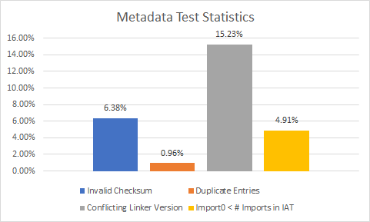
Invalid Metadata Test Stats
Notes:
Surveyed ~450,000 malware samples

Slide 58
OlympicDestroyer vs Basic Metadata Tests
Passes checksum, duplicate entries, linker tests
Fails import count tests
Notes:
Rich import count: 77 / IAT import count 93
Mostly a fluke

Slide 59
RLPack vs Basic Metadata Tests
Passes all of our tests
Sets PE header linker version to 5:12 (matches Rich header)
Doesn’t have an Import0 entry
Uncommon but not necessarily an indicator of tampering

Slide 60
Conclusion

Slide 61
Acknowledgements
Dr. Charles Nicholas and Dr. Haibin Zhang, UMBC CSEE Dept
Matt Elder and Bill La Cholter, Johns Hopkins APL
The ShadowServer Foundation
Mila Parkour, DeepEnd Research

Slide 62
Source Code
https://github.com/RichHeaderResearch/RichPE

Slide 63
Questions?

Slide 64
References
https://www.ntcore.com/files/richsign.htm
https://bytepointer.com/articles/the_microsoft_rich_header.htm
https://www.sec.in.tum.de/i20/publications/finding-the-needle-a-study-of-the-pe32-rich-header-and-respective-malware-triage
https://securelist.com/the-devils-in-the-rich-header/84348/
http://ropgadget.com/posts/richheader_hunting.html
https://docs.microsoft.com/en-us/previous-versions/ms809762(v=msdn.10)
https://github.com/erocarrera/pefile/blob/master/pefile.py
https://yara.readthedocs.io/en/v3.8.1/
Notes:
Thanks and ask for stuff

Slide 65
Pefile Python Library
Awesome Python library for parsing the PE header
Can use it to parse a file’s Rich header
https://github.com/erocarrera/pefile

